Slide 1

Artificial Intelligence in Finance at Hong Kong University of Science and Technology
Notes:
What does “greedy” refer to for “greedy algorithm”?
Optimal at the current step
Monetary reward gained in the training process
Binary splitting using neural networks
None of the above
What happens when there are too few steps of splitting in a tree?
Large bias, large variance
Large bias, small variance
Small bias, large variance
Small bias, small variance
In a decision tree, if the current split is ineffective, future splits can still be effective (even very effective).
True
False
Which of the following are usually used to evaluate the quality of a split in a classification tree?
Gini-index and splitting bias
Cross-entropy and splitting bias
Gini-index and cross-entropy
All of the above
Which of the following is true about bagging?
Works best for high variance and high bias learning methods
Works best for high variance and low bias learning methods
Works best for low variance and high bias learning methods
Works best for low variance and low bias learning methods
Which of the following is true about boosting?
A combination of many weaker learners to produce a strong learner.
Weaker learners are usually created in parallel.
Boosting is only applicable for classification problems.
None of the above

Slide 2
www.slido.com
#UST

Slide 3

Codename
awoo@post.Harvard.edu
Project Quantum
Project Redbook
Project Dragon
Project Oasis
Project Fire

Slide 4
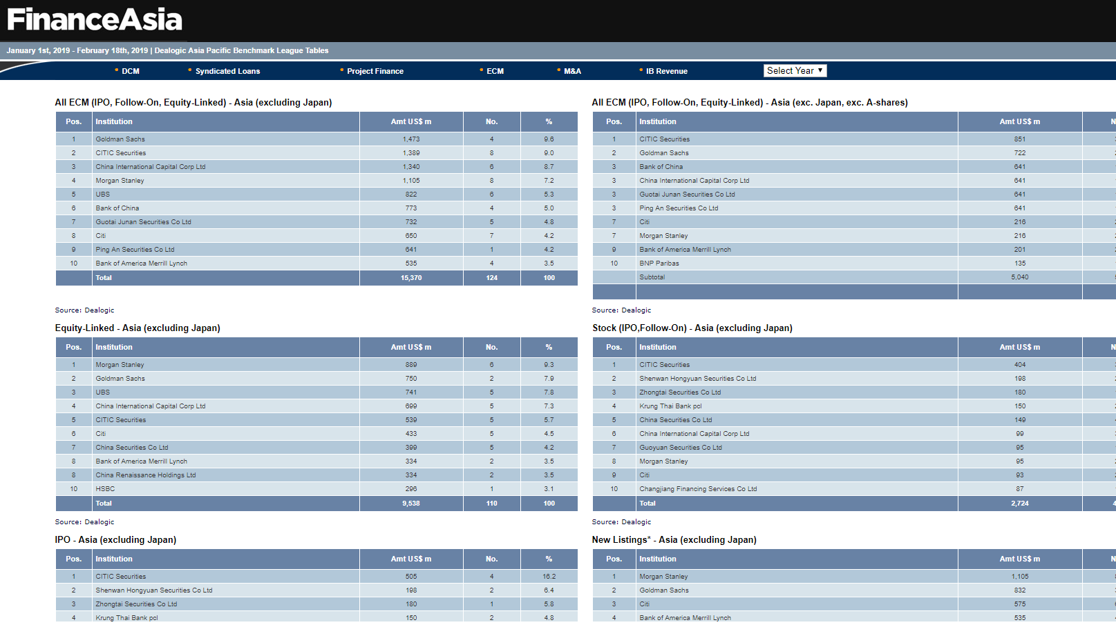

Slide 5
Note on Banking
Investment Bank
Universal Bank
An Investment Bank is a financial institution that deals with raising capital, trading in securities and managing corporate mergers and acquisitions. Investment banks profit from companies and governments by raising money through issuing and selling securities in the capital markets and insuring bonds (selling CDS), as well as providing advice on transactions such as mergers and acquisitions.
A Universal Bank participates in many kinds of banking activities and is both a commercial bank and an investment bank as well as providing other financial services such as insurance. These are also called full-service financial firms, although there can also be full-service investment banks which provide wealth and asset management, trading, underwriting, researching as well as financial advisory.

Slide 6
Note on Banking (Cont’d)
Banking History
Regulations
The concept is most relevant in the United Kingdom and the United States, where historically there was a distinction drawn between pure investment banks and commercial banks. In the US, this was a result of the Glass-Steagall Act of 1933.
In both countries, however, the regulatory barrier to the combination of investment banks and commercial banks has largely been removed, and a number of universal banks have emerged in both jurisdictions. However, at least until the global financial crisis of 2008, there remained a number of large, pure investment banks.
Glass-Steagall Act of 1933: Prohibited commercial banks from engaging in corporate securities offering
Securities Exchange Act of 1934: Established the Securities & Exchange Commission (SEC)
Gramm-Leach-Bliley Act of 1999: Repealed Glass-Steagall Act of 1933

Slide 7

Dr Jeffrey Hui, a seasoned educationalist and strategist, is currently serving as Managing Director of InnoSights, Founder and Principal of Dr. Phoenix Global Education Group, Producer-in-Chief (Education) and Host of Metro Broadcast Corporation, Honourary Advisor and Former Chairperson of Hong Kong Institute of Marketing as well as Founding Chairperson of Phoenix Intellectuals Foundation.
As a well-rounded marketing and management professional, Jeffrey served at various top-notch business, media and educational organizations, including Procter & Gamble (P&G), Cathy Pacific Airways (CX), Television Broadcasts Limited (TVB), Radio Television Hong Kong (RTHK) and King’s Glory Education (KGE). Being a scholar-of-practice, Jeffrey has keen interest in the research of management theories and practices. Since 2002, he has been conducting extensive face-to-face interviews of over 1,000 reputed CEOs, scholars, business and community leaders from a wide range of fields in Hong Kong and The Greater China.
As a veteran educator, Jeffrey has been the faculty at a number of tertiary institutions, including The Chinese University of Hong Kong, The Polytechnic University of Hong Kong, The Chinese University of Hong Kong (Shenzhen) and The Hang Seng University of Hong Kong. Delivering an outstanding level of teaching and training, Jeffrey was elected as “The Best Lecturer of the Year” (ranked 1st among 104 university lecturers) in 2009 and achieved full score of 6.00/6.00 for his teaching evaluation in 2018.
As a passionate education expert, Jeffrey has also been serving in multiple education advisory roles for various universities and governmental bodies, including Academic Advisor, The Chinese University of Hong Kong (CUHK) and Hong Kong Shue Yan University (HKSYU); External Examiner, The Polytechnic University of Hong Kong (PolyU); Appointed Specialist (Education, Business and Management), The Hong Kong Council for Accreditation of Academic & Vocational Qualifications (HKCAAVQ), Hong Kong SAR Government; Adjunct Professor in Marketing, Guangdong Food and Drug Vocational College, etc.
Dr. Jeffrey Hui (凌羽一博士)
Managing Director, InnoSightsFounder and Principal, Dr. Phoenix Global Education GroupProducer-in-Chief (Education) Founding Chairperson, Phoenix Intellectuals Foundation
EdD (Bristol), MSt (Cand) (Cambridge), EMBA (CUHK), MA (HKU), BBA (Hons) (CUHK), Beta Gamma Sigma (Life), SHKIM (Life), ProM, FIMS, DTM, CNLPT, CNLPMP

Slide 8
As an experienced education strategist, Jeffrey has been helping hundreds of students in college applications. Numerous students, mentees and coachees of Jeffrey have successfully obtained offers for bachelor, masters and doctoral studies in a vast mix of world-class universities, including: University of Cambridge, University of Oxford, Harvard University, Yale University, Stanford University, Massachusetts Institute of Technology, Columbia University, University of California at Berkeley, University of Los Angeles, London School of Economics and Political Science, Imperial College London, University College London, etc.
Jeffrey’s coaching does not only confine to college applications, but also extended to career developments. Hundreds of Jeffrey students, mentees and coachees have been hired by Fortune 500 and other renowned corporations, e.g. McKinsey & Co., BCG, Bain, Google, Tencent, UBER, Goldman Sachs, UBS, HSBC, Standard Chartered, Citibank, Value Partners, PwC, Deloitte, Ernst and Young, KPMG, P&G, L’Oreal, Unilever, Nestlé, Estee Lauder, Coca Cola, Johnson & Johnson, Pfizer, AstraZeneca, Cathay Pacific, Swire Properties, etc Jeffrey has also authored and co-authored several top-selling books on branding, marketing, strategies and management, including:《贏銷策略──打造品牌必讀50例》，《商識滿天下──香港商管翹楚30訪》，《讓品牌「飛」!──策略社交媒體、網絡營銷實戰秘笈》* ，《品牌超連結──十大Marketers成功實學》* and 《贏銷0與1》* (*NO. 1 Finance and Business Category Bestseller at Eslite誠品書店).
In appreciation to his in contributions and achievements in education and social services, Jeffrey was granted “The 3rd Global Chinese Outstanding Youth Award”, “The 6th Young Leaders Award” as well as “The 4th Youth DreamMakers Award”.
Dr. Jeffrey Hui (凌羽一博士)
Managing Director, InnoSightsFounder and Principal, Dr. Phoenix Global Education GroupProducer-in-Chief (Education) Founding Chairperson, Phoenix Intellectuals Foundation
EdD (Bristol), MSt (Cand) (Cambridge), EMBA (CUHK), MA (HKU), BBA (Hons) (CUHK), Beta Gamma Sigma (Life), SHKIM (Life), ProM, FIMS, DTM, CNLPT, CNLPMP

Slide 9

Blockchain
As the underlying technology of Bitcoin, Blockchain (also known as Distributed Ledger Technology or “DLT”) is a self-sustaining, peer-to-peer ledger technology, using peer-to-peer network, distributed consensus, and cryptography, negating the need for a central authority for trust.
Credit: https://ninesilos.wordpress.com/tag/blocks/
Source: Harvard Business School “Blockchain Note” by HBS Prof. David Yoffie and Researcher Anthony Woo
Anthony Woo • Harvard Business School Asia-Pacific Research Center

Slide 10

P2P Networking & Distributed Consensus
Credit: https://moodle.glyndwr.ac.uk/course/view.php?id=20&section=12
Anthony Woo • Harvard Business School Asia-Pacific Research Center

Slide 11
Block
Header
Content
Footer
Anthony Woo • Harvard Business School Asia-Pacific Research Center

Slide 12
Hash Function
Hash Function Any function that can be used to map data of arbitrary size to a fixed size
Properties
Extremely easy to calculate a hash for any given data
Extremely computationally difficult to calculate an alphanumeric text that has a given hash
Extremely unlikely that two slightly different messages will have the same hash
Bitcoin Hash
Secure Hash Algorithm
Member of the SHA-2 cryptographic hash functions used in Bitcoin by NSA¹
Input
Hash
Output
China
Hash Function
2EGS 4VB5 B7XW
RMB 100 million
Hash Function
AV7X 6BNM K3RH
This is Hong Kong
Hash Function
4SNQ PR2B TQOU
Tis is Hong Kong
Hash Function
FDO8 1JGI QP8E
Sources:
https://en.wikipedia.org/wiki/Hash_function
https://simple.wikipedia.org/wiki/Cryptographic_hash_function
Note: 1. National Security Agency
Anthony Woo • Harvard Business School Asia-Pacific Research Center

Slide 13
Block + Hash Function
Header
Content
Hash Function
RSLK Y38V W6HD
Footer
Anthony Woo • Harvard Business School Asia-Pacific Research Center

Slide 14
Block + Hash Function
Header
Header
Content
Hash Function
RSLK Y38V W6HD
Content
Footer
RSLK Y38V W6HD
Footer
Anthony Woo • Harvard Business School Asia-Pacific Research Center

Slide 15
Block + Block
2EGS 4VB5 B7XW
RSLK Y38V W6HD
Hash Function
Hash Function
RSLK Y38V W6HD
XDF4 GXCV ROS2
Anthony Woo • Harvard Business School Asia-Pacific Research Center

Slide 16
Block + Block + Block...
Anthony Woo • Harvard Business School Asia-Pacific Research Center

Slide 17



Bitcoin Mining
R6XE FY3C 6BW4
Header
5XD3 B5EP DHRW
Content
Hash Function
4R53 B2BE XOMR
00RP Y38V W6HD
Nonce
0000 Y38V W6HD
Anthony Woo
Harvard Business School Asia-Pacific Research Center

Slide 18
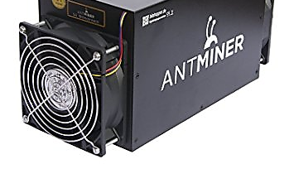
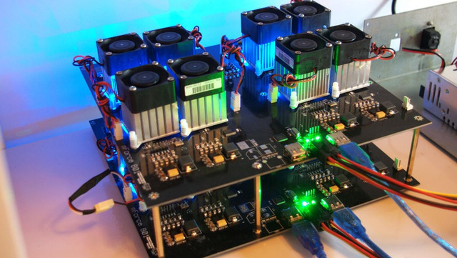

Bitcoin Mining
Sources:
https://99bitcoins.com/20-insane-bitcoin-mining-rigs/
https://pool.bitcoin.com/index_en.html
https://www.cryptocompare.com/mining/sapphire/radeon-r9-290x-tri-x-ethereum-mining/
Anthony Woo • Harvard Business School Asia-Pacific Research Center

Slide 19
Bitcoin Mining
Flexibility & Ease of Use
Performance & Power Efficiency
Source: https://ngcodec.com/markets-cloud-transcoding/
Anthony Woo • Harvard Business School Asia-Pacific Research Center

Slide 20
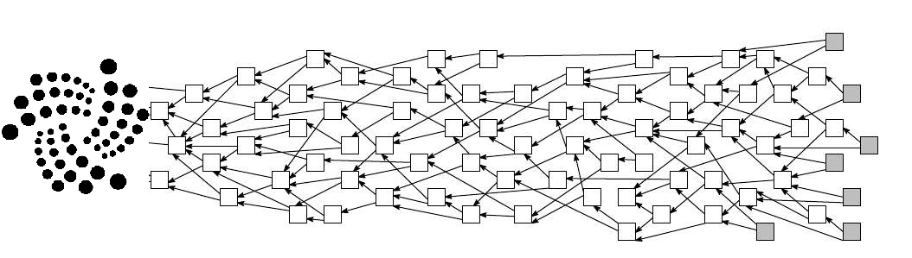
IOTA: Tangle
Source: https://iota.org/
Anthony Woo • Harvard Business School Asia-Pacific Research Center

Slide 21
Asset Management Framework
Value
Core
Growth
Large Cap
Large cap companies are generally valued at US$5 billion of above. These companies are known to be less volatile and focused more on stable dividend payouts.
Large Cap Value
Large Cap Core
Large Cap Growth
Value
Value investments take a look at companies that are trading at below average/bargain prices. Investors buy at this point to buy low and sell high.
Large
Mid Cap
These middle sized companies are focusing on becoming large cap companies. Investors look to capture their growth returns.
Mid Cap Value
Mid Cap Core
Mid Cap Growth
Core
Core investments have a balance of value and growth investments in one portfolio (also known as "Blended").
Mid
Small Cap
Small cap are "up and coming" companies that are focused on substantial growth. They are also the most volatile because they have the biggest incidence of business failures.
Small Cap Value
Small Cap Core
Small Cap Growth
Growth
Growth investments look at trends in the market. If a specific company is expected to grow substantially, investors will buy into it.
Small
Source: http://dropwealth.com/2017/03/7-types-stock-use/
Past performance is not indicative of future returns.
Anthony Woo • Harvard Business School Asia-Pacific Research Center

Slide 22
Correlation with Bitcoin
Value
Core
Growth
Large Cap
Large cap companies are generally valued at US$5 billion of above. These companies are known to be less volatile and focused more on stable dividend payouts.
0.68
0.58
0.66
0.60
0.68
0.61
Value
Value investments take a look at companies that are trading at below average/bargain prices. Investors buy at this point to buy low and sell high.
Large
Mid Cap
These middle sized companies are focusing on becoming large cap companies. Investors look to capture their growth returns.
0.63
0.55
0.66
0.59
0.66
0.60
Core
Core investments have a balance of value and growth investments in one portfolio (also known as "Blended").
Mid
Small Cap
Small cap are "up and coming" companies that are focused on substantial growth. They are also the most volatile because they have the biggest incidence of business failures.
0.67
0.60
0.69
0.60
0.68
0.60
Growth
Growth investments look at trends in the market. If a specific company is expected to grow substantially, investors will buy into it.
Small
As of October 2017
Note: iShares ETF products used as a proxy for each asset class
Source: https://www.ishares.com/us/products/etf-product-list
Past performance is not indicative of future returns.
As of January 2018
Anthony Woo • Harvard Business School Asia-Pacific Research Center

Slide 23
Risk vs. Return Analysis: Multiples Approach
United States
As of October 2017
United States
As of January 2018
Average Return Multiple = 21.4x
Average Return Multiple = 15.9x
Average Volatility Multiple = 15.5x
Average Volatility Multiple = 16.1x
Note: iShares ETF products used as a proxy for each asset class
Source: https://www.ishares.com/us/products/etf-product-list
Past performance is not indicative of future returns.
Return Multiple – 5 Year
Volatility Multiple – 5 Year
Anthony Woo • Harvard Business School Asia-Pacific Research Center

Slide 24
Risk vs. Return Analysis: Sharpe Ratio
United States
Global
Sharpe Ratio – 1 Year
Notes:
iShares ETF products used as a proxy for each asset class
Risk free rate based on the U.S. Generic Government 10-Year Yield (USGG10YR:IND) from Bloomberg
Source: https://www.ishares.com/us/products/etf-product-list
Past performance is not indicative of future returns.
Sharpe Ratio – 5 Year
Anthony Woo • Harvard Business School Asia-Pacific Research Center

Slide 25
Risk Analysis: Maximum Drawdown
United States
Global
Note: iShares ETF products used as a proxy for each asset class
Source: https://www.ishares.com/us/products/etf-product-list
Past performance is not indicative of future returns.
Anthony Woo • Harvard Business School Asia-Pacific Research Center

Slide 26
Return Analysis: Up vs. Down
United States
Global
Note: iShares ETF products used as a proxy for each asset class
Source: https://www.ishares.com/us/products/etf-product-list
Past performance is not indicative of future returns.
Anthony Woo • Harvard Business School Asia-Pacific Research Center

Slide 27



Exogenous Risks
ICO
Hacking
ICO Regulation
Exchange Regulation
Collapse of Mt. Gox (largest cryptocurrency exchange in 2013, handling over 70% of all bitcoin volume)
Hacking of Bitfinex¹ (the world’s largest bitcoin exchange with 12% volume)
Global crackdown on ICOs
General consensus: Tokens = Securities
Future ICOs may require appropriate regulatory agency, a prospectus, and limited to accredited investors
Removal of gateways between fiat currencies and cryptocurrencies
Chinese bitcoin market is pricing in that all major cryptocurrency exchanges in China will be closed
Credits:
https://thenounproject.com/term/mountain/70698/
https://thenounproject.com/term/exchange/136901/
Source: https://medium.com/@Truth_Investor/bitcoin-three-ways-the-bubble-will-pop-40678ce11698
Note: 1. Bitfinex is a crypto-currency exchange trading and currency-storage platform based out of Hong Kong and owned and operated by iFinex Inc.
Anthony Woo • Harvard Business School Asia-Pacific Research Center

Slide 28

Initial Coin Offerings (ICOs)
An entity offers investors some units of a new cryptocurrency or crypto-token in exchange against cryptocurrencies such as Bitcoin or Ethereum
An unregulated means of crowdfunding via use of cryptocurrency, which can be a source of capital for startup companies
A percentage of the newly issued cryptocurrency is sold to investors in exchange for legal tender or other cryptocurrencies
Sources:
https://blockgeeks.com/guides/what-is-an-initial-coin-offering/
https://medium.com/@Truth_Investor/bitcoin-three-ways-the-bubble-will-pop-40678ce11698
Credit;
http://www.kabukencafe.com/list-of-companies/large-stock-certificate/Microsoft.htm
Anthony Woo • Harvard Business School Asia-Pacific Research Center

Slide 29
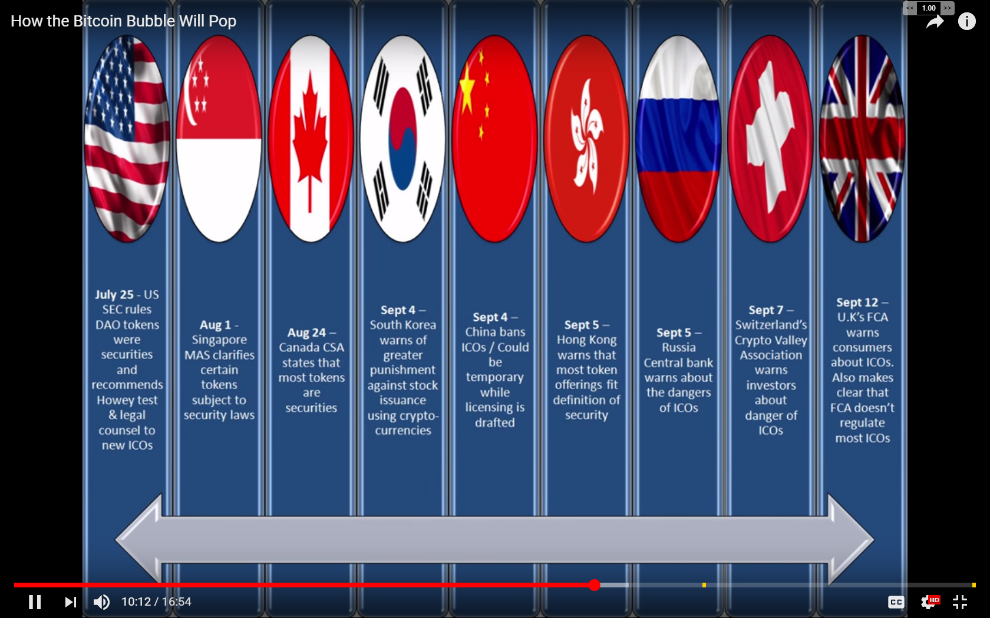
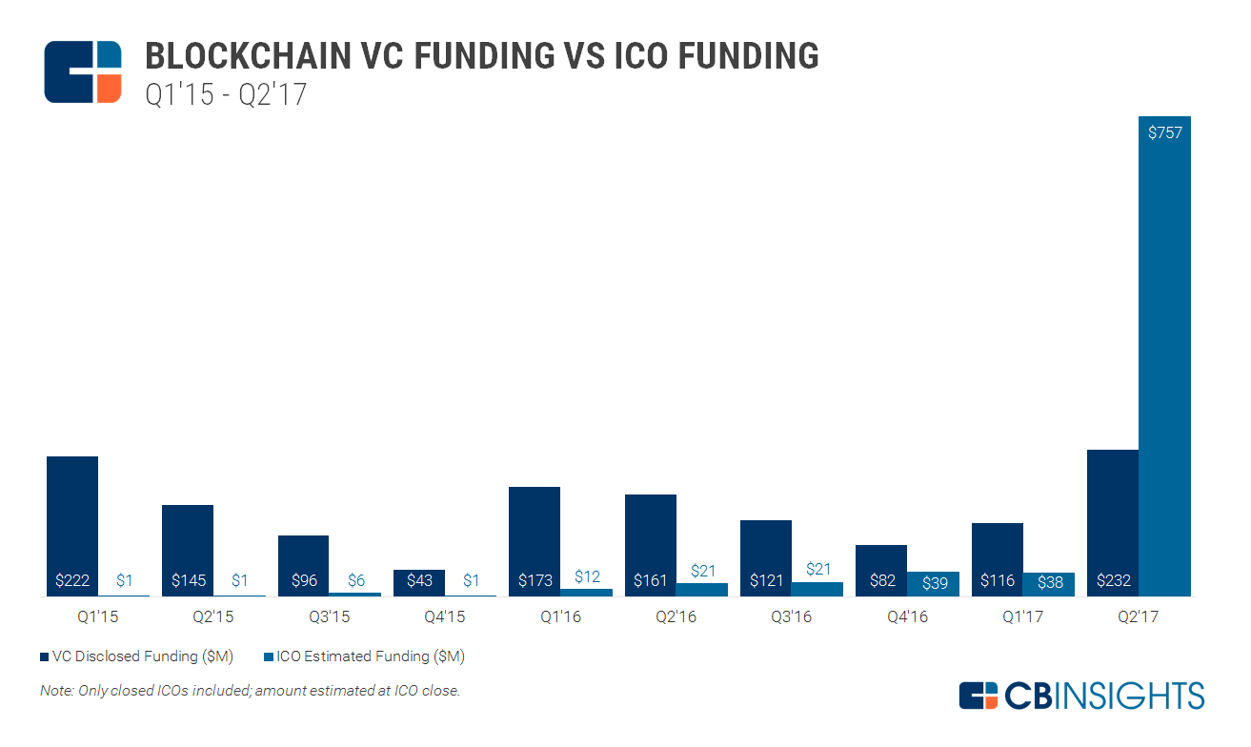
Geopolitical Variations for ICOs
VC Disclosed Funding – US$ MM
ICO Estimated Funding – US$ MM
Switzerland
Singapore
United States
United Kingdom
China
Russia
Switzerland’s Crypto Valley Association warns investors about danger of ICOs
Singapore MAS clarifies certain tokens are subject to security laws
U.S. SEC rules DAO tokens were securities and recommends Howey test and legal counsel to new ICOs
U.K. FCA warns consumers about ICOS, and makes clear that FCO does not regulate most ICOs
China bans ICOs (which could be temporary while licensing is drafted)
Russia Central Bank warns about the dangers of ICOs
Sources:
https://medium.com/@Truth_Investor/bitcoin-three-ways-the-bubble-will-pop-40678ce11698
https://www.coindesk.com/state-ico-regulation-new-report-outlines-legal-status-6-nations/
https://www.cbinsights.com/research/blockchain-startup-deals-ico-trend/
Anthony Woo • Harvard Business School Asia-Pacific Research Center

Slide 30

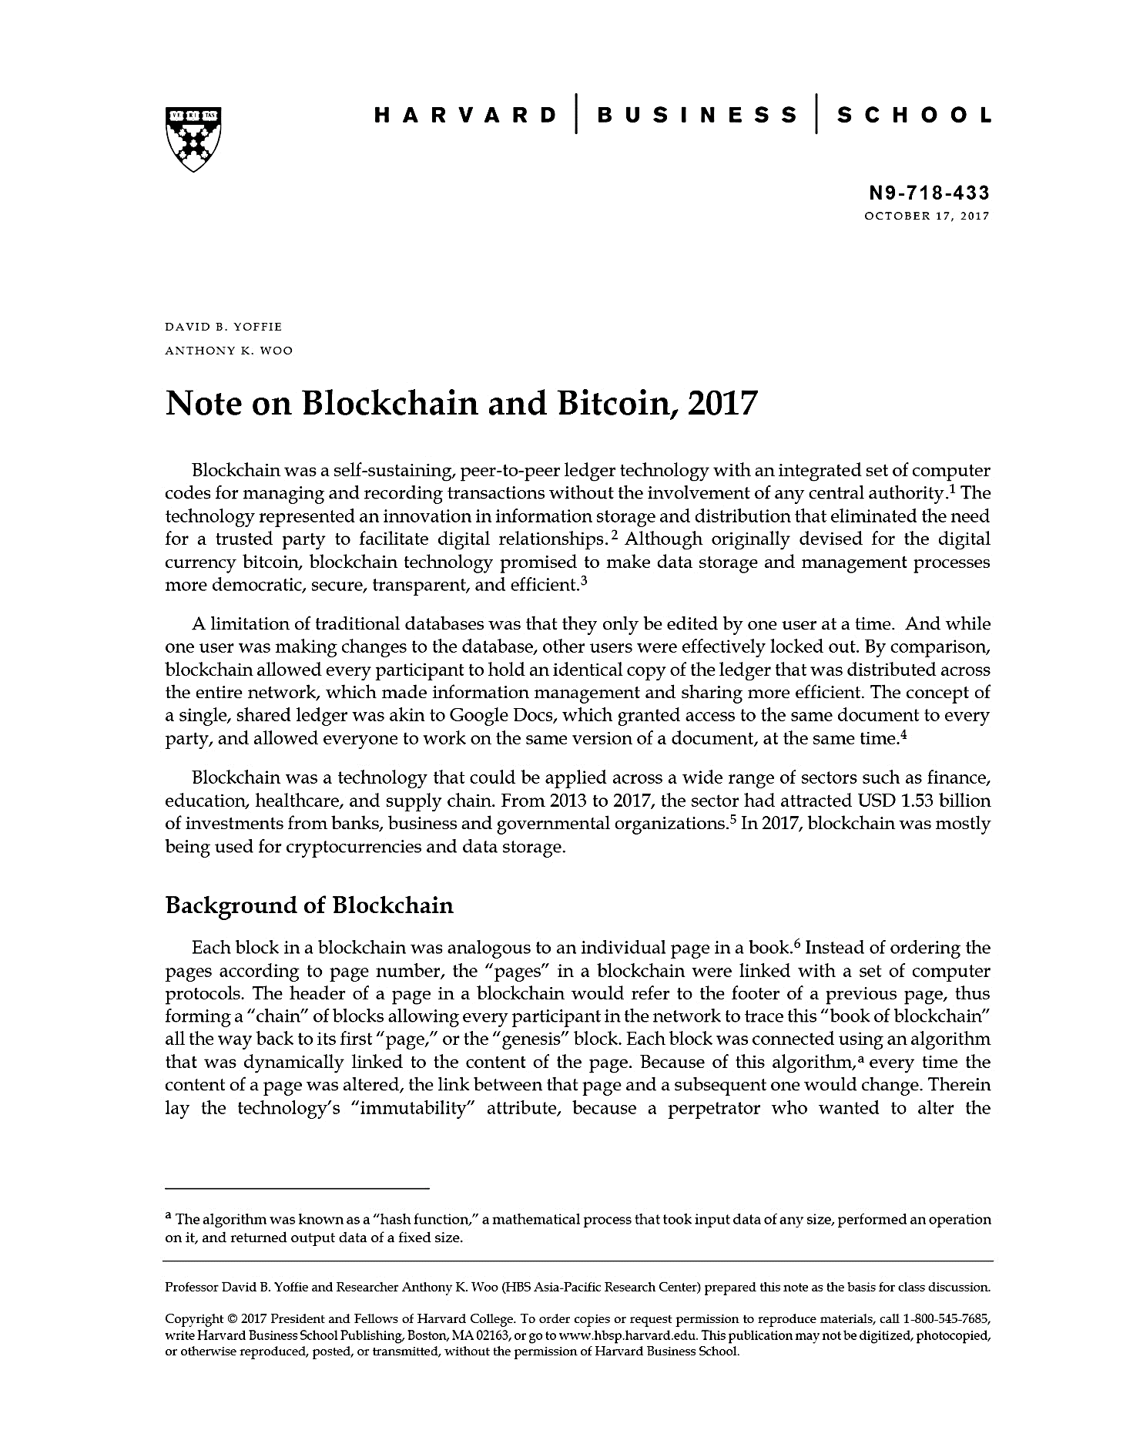
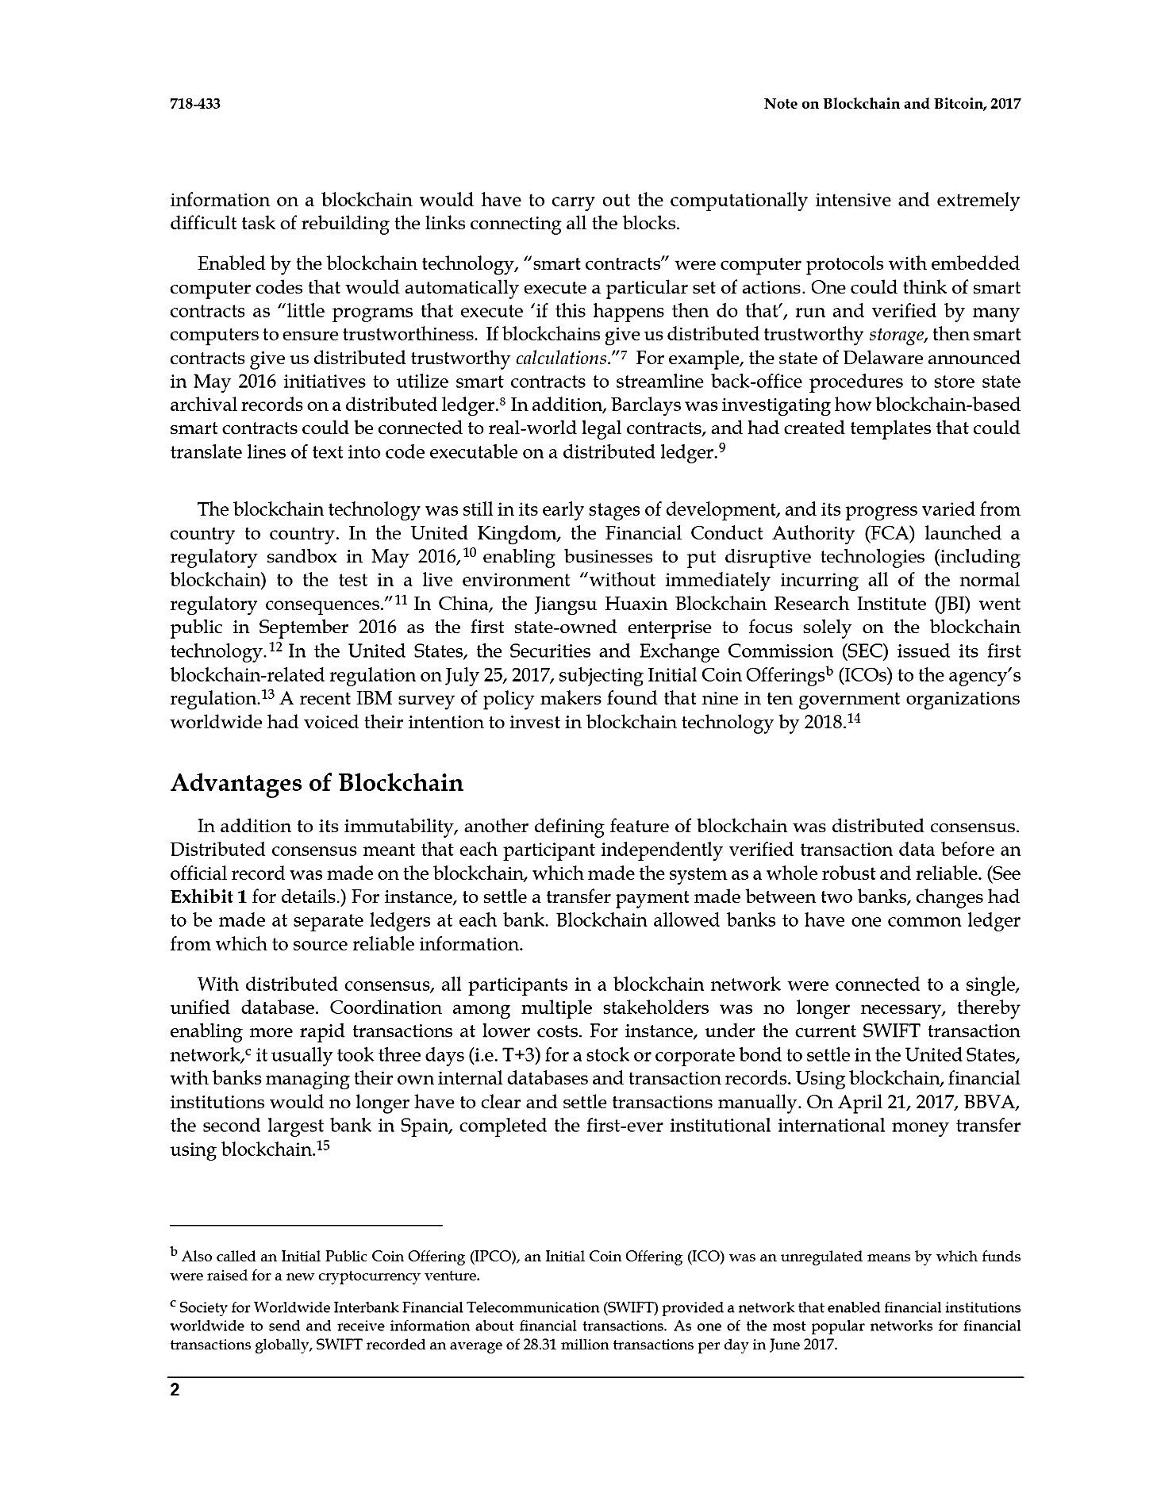

Slide 31
Blockchain: Supply Chain Finance Use Case
Supplier A
Supplier B
Supplier C
Supplier D
Supplier E
Supplier F
Increasing opacity of information along the supply chain
Supplier 1
Supplier 2
Supplier 3
Main Supplier
Company
Source: Harvard Business School Case Study
Anthony Woo • Harvard Business School Asia-Pacific Research Center

Slide 32
Blockchain: Education Use Case
MIT Digital Certificates Project
An incubation project by the Media Lab Learning Initiative and Learning Machine that builds an ecosystem for creating, sharing, and verifying blockchain-based educational certificates. Digital certificates are registered on the Bitcoin blockchain, cryptographically signed, and tamper proof. All code is open-source and open to feedback, contributions, and general discussion.
Sample Deployments
The Media Lab issued digital certificates (nicknamed “coins”) to Media Lab alumni who attended the Lab’s 30th anniversary in October 2015.
Learning Machine issued digital certificates to all of its employees.
MIT's Global Entrepreneurship Bootcamp issued digital certificates to the students that attended their workshop in Seoul, South Korea in March 2016.
The Laboratorio para la Ciudad issued digital certificates to participants of a week-long workshop in Mexico City in September 2016.
Source: Massachusetts Institute of Technology
Anthony Woo • Harvard Business School Asia-Pacific Research Center

Slide 33
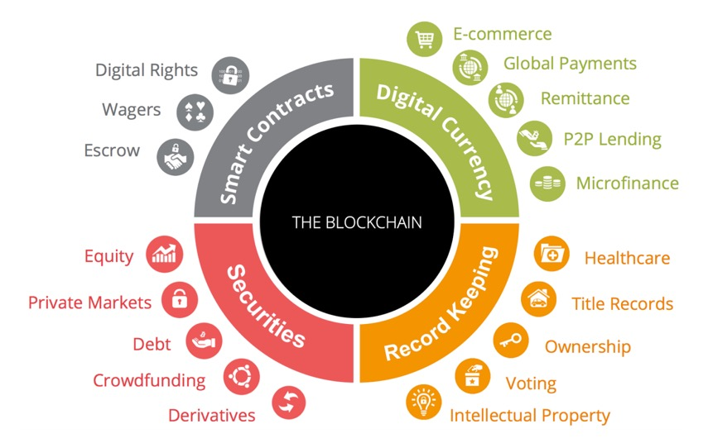
Use Cases
Source: https://www.aciworldwide.com/insights/expert-view/2017/march/blockchain-for-retailers-producing-real-business-benefits

Slide 34
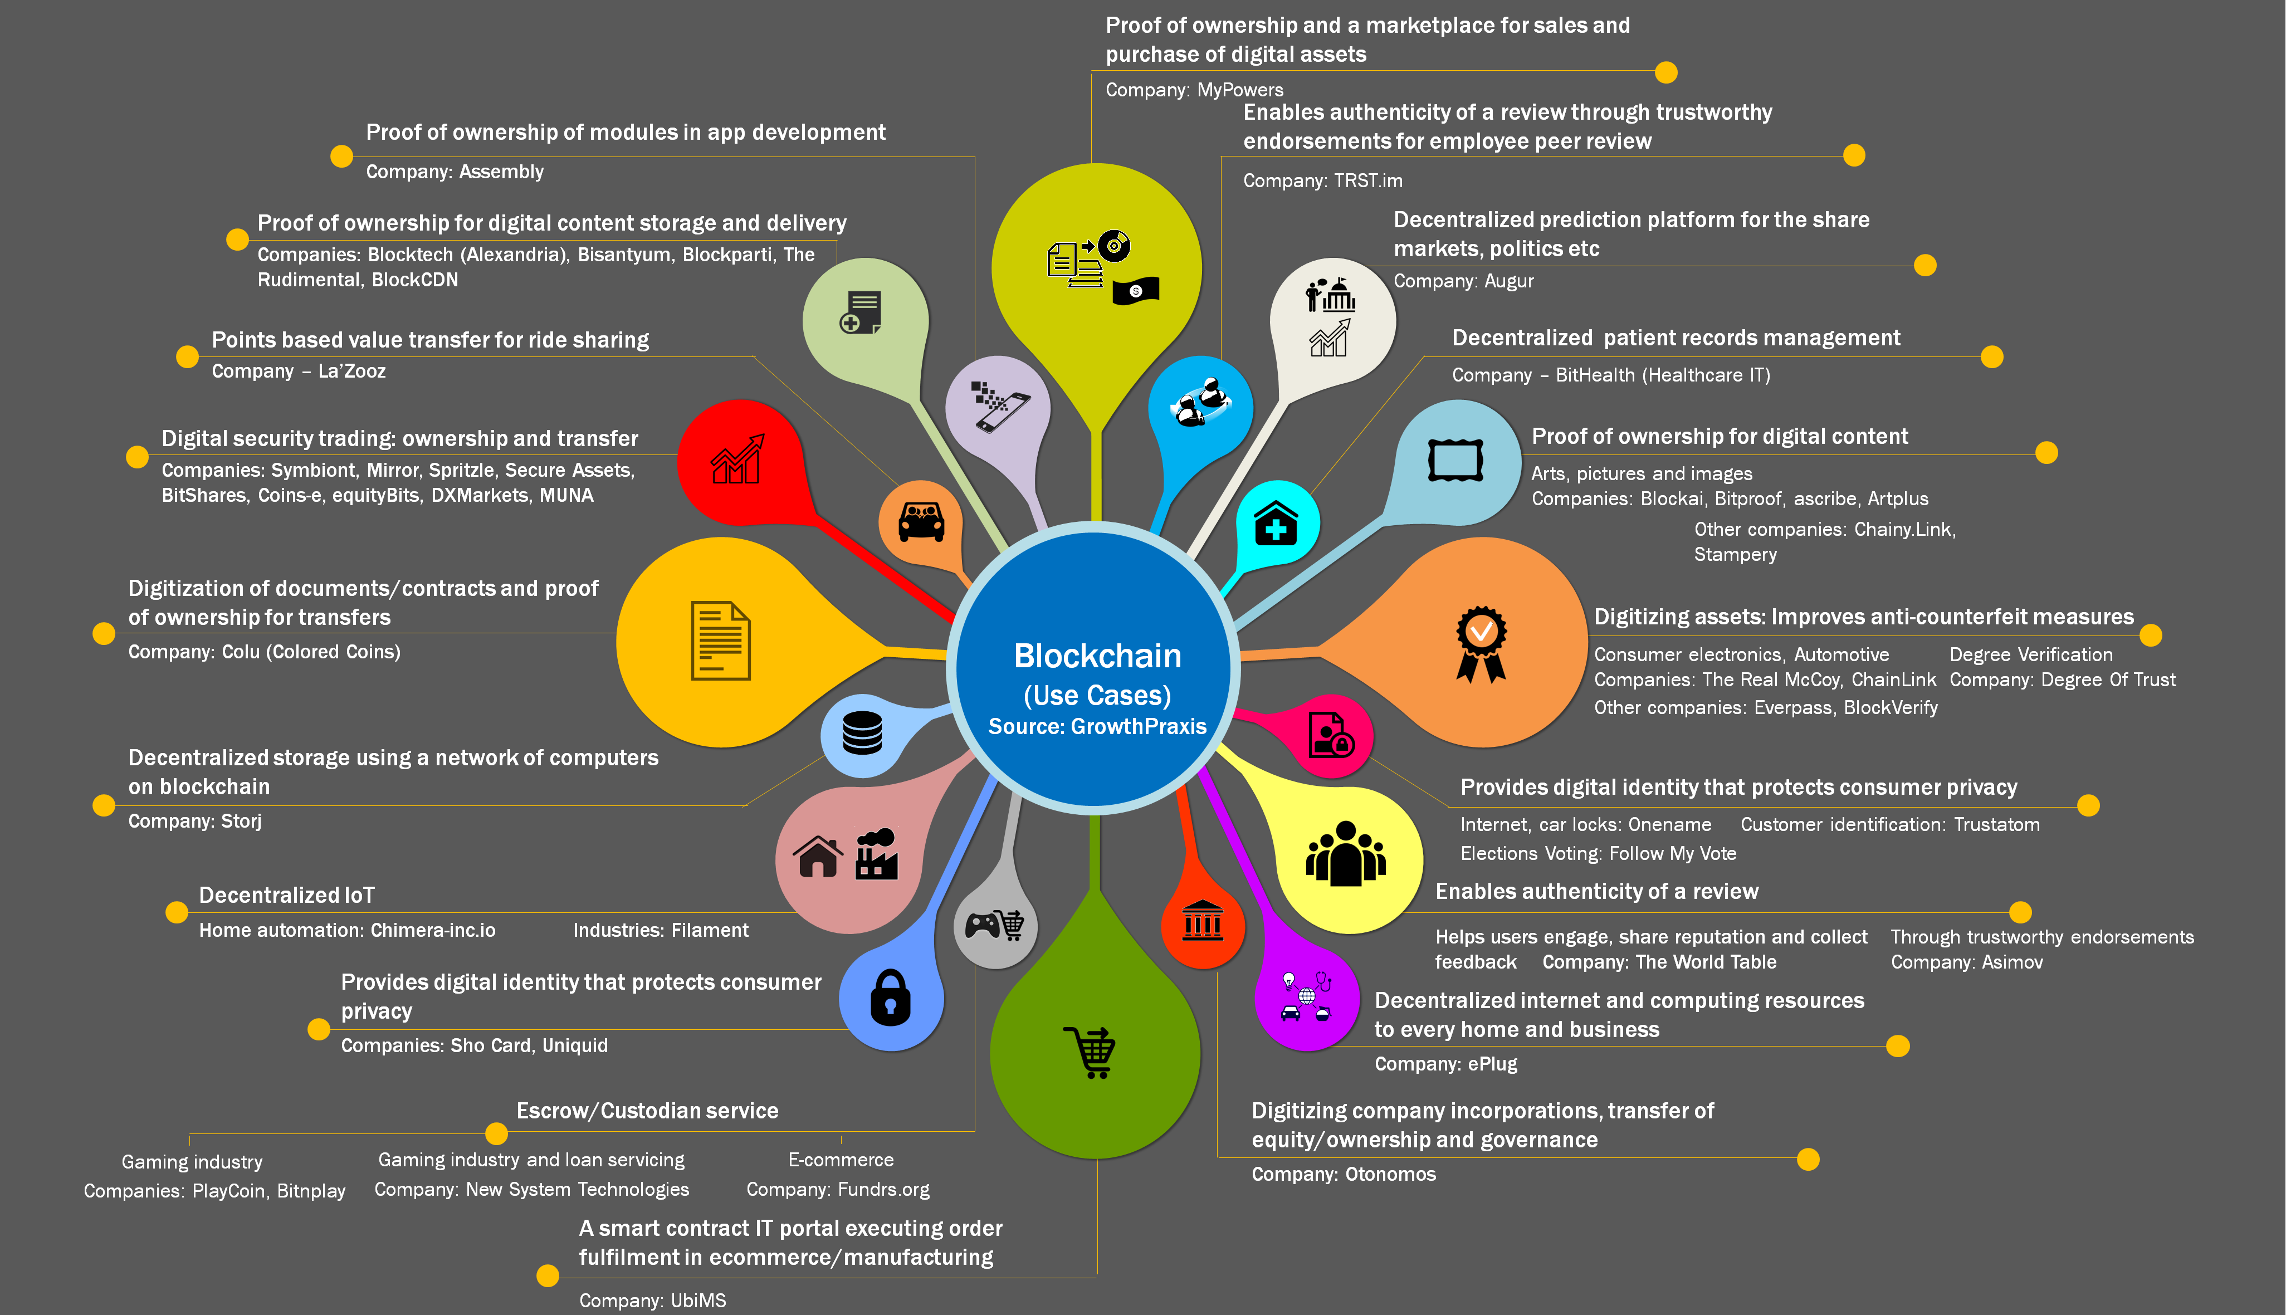

Slide 35
Blockchain Coding
import java.lang.reflect.Array;
import java.util.Arrays;
public class Block {
private int previousHash;
private String[] transactions;
private int blockHash;
public Block(int previousHash, String[] transactions) {
this.previousHash = previousHash;
this.transactions = transactions;
Object[] contents = {Arrays.hashCode(transactions), previousHash};
this.blockHash = Arrays.hashCode(contents);
}
public int getPreviousHash() {
return previousHash;
}
public String[] getTransaction() {
return transactions;
}
public int getBlockHash() {
return blockHash;
}
}
import java.util.Arrays;
public class Main {
public static void main(String[] args) {
String[] genesisTransactions = {“A gives B 10", “B gives C 20"};
Block genesisBlock = new Block(0, genesisTransactions);
String[] block2Transactions = {“C gives B 5", “B gives A 5"};
Block block2 = new Block(genesisBlock.getBlockHash(), block2Transactions);
String[] block3Transactions = {“B gives E 30"};
Block block3 = new Block(block2.getBlockHash(), block3Transactions);
System.out.println("Hash of genesis block:");
System.out.println(genesisBlock.getBlockHash());
System.out.println("Hash of block 2:");
System.out.println(block2.getBlockHash());
System.out.println("Hash of block 3:");
System.out.println(block3.getBlockHash());
}
}
Source: https://github.com/ivan-liljeqvist/SimpleBlockchain/

Slide 36
Blockchain Coding
import java.lang.reflect.Array;
import java.util.Arrays;
public class Block {
private int previousHash;
private String[] transactions;
private int blockHash;
public Block(int previousHash, String[] transactions) {
this.previousHash = previousHash;
this.transactions = transactions;
Object[] contents = {Arrays.hashCode(transactions), previousHash};
this.blockHash = Arrays.hashCode(contents);
}
public int getPreviousHash() {
return previousHash;
}
public String[] getTransaction() {
return transactions;
}
public int getBlockHash() {
return blockHash;
}
}
import java.util.Arrays;
public class Main {
public static void main(String[] args) {
String[] genesisTransactions = {“A gives B 10", “B gives C 20"};
Block genesisBlock = new Block(0, genesisTransactions);
String[] block2Transactions = {“C gives B 5", “B gives A 5"};
Block block2 = new Block(genesisBlock.getBlockHash(), block2Transactions);
String[] block3Transactions = {“B gives E 30"};
Block block3 = new Block(block2.getBlockHash(), block3Transactions);
System.out.println("Hash of genesis block:");
System.out.println(genesisBlock.getBlockHash());
System.out.println("Hash of block 2:");
System.out.println(block2.getBlockHash());
System.out.println("Hash of block 3:");
System.out.println(block3.getBlockHash());
}
}
Source: https://github.com/ivan-liljeqvist/SimpleBlockchain/

Slide 37
Smart Contracts
contract MyToken {
/* This creates an array with all balances */
mapping (address => uint256) public balanceOf;
/* Initializes contract with initial supply tokens to the creator of the contract */
function MyToken(
uint256 initialSupply
) {
balanceOf[msg.sender] = initialSupply; // Give the creator all initial tokens
}
/* Send coins */
function transfer(address _to, uint256 _value) {
require(balanceOf[msg.sender] >= _value); // Check if the sender has enough
require(balanceOf[_to] + _value >= balanceOf[_to]); // Check for overflows
balanceOf[msg.sender] -= _value; // Subtract from the sender
balanceOf[_to] += _value; // Add the same to the recipient
}
}
Source: https://www.ethereum.org/token

